Slide 1
Introduction to Data Visualization
Data Visualization Course – Lecture 1
DATA VISUALIZATION
Mr. Ali Haider
Institute Of Management Sciences
Dr. Muhammad Sajjad
R.A: Imran Nawar
September 2024
1

Slide 2

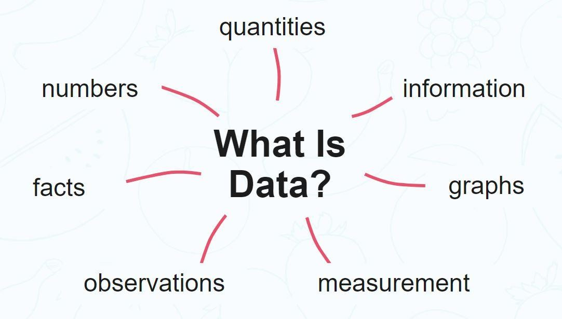
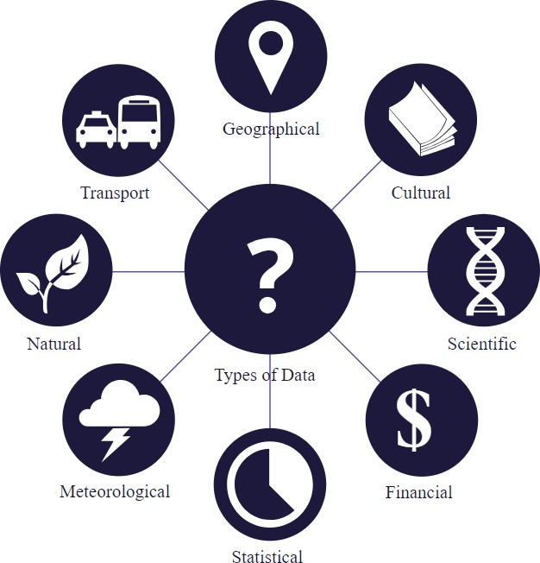
What is Data?
Data is information in raw or unorganized form
A collection of facts, statistics, or information that can be analyzed, processed, and interpreted to derive meaningful insights.
It’s the building block of insights and decisions
Data comes in various types:
Numbers
Text
Images
Speech
etc.
Examples:
Yes, Yes, No, Yes, No, Yes, No, Yes
42, 63, 96, 74, 56, 86
None of the above data sets have any meaning until they are given a CONTEXT and PROCESSED into a useable form
Information is data that has been processed, organized, or structured in a way that makes it meaningful, valuable and useful.
3

Slide 3
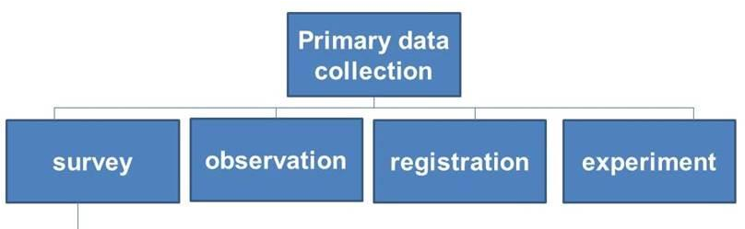
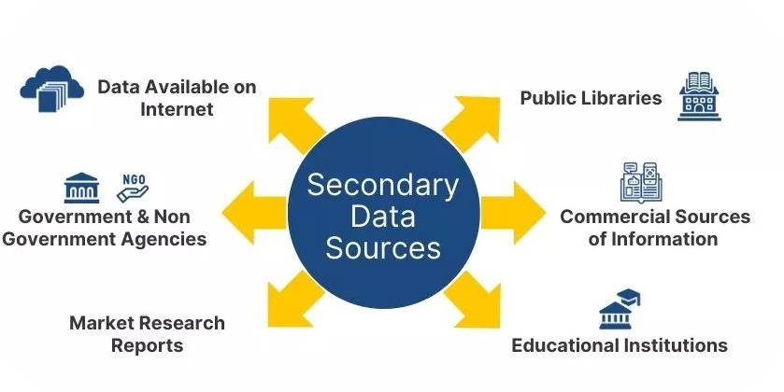
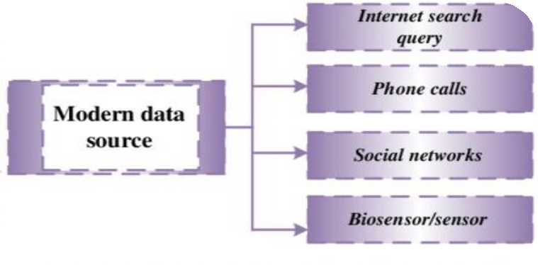
Sources of Data
Primary sources:
Surveys and questionnaires
Experiments and observations
Secondary sources:
Databases: Public or private data collections.
Government databases (e.g., census data)
Academic research publications
Web scraping
Modern Data sources:
Big Data: Vast datasets from varied sources.
User-generated content (social media, online reviews)
Business transactions (e-commerce, financial records)
Scientific experiments (large-scale research, simulations)
Sensors and IoT devices (smart cities etc.)
Surveillance systems (security cameras)
Medical Data (electronic health records, medical imaging, etc.)
4

Slide 4
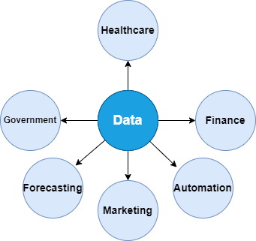
Importance of Data in the Modern World
Why Data Matters?
Data-Driven Decision Making:
Essential in businesses, healthcare, finance, etc.
Helps make better decisions.
Powering AI and Machine Learning:
Foundation for training models and making predictions.
Enables automation in various applications.
Innovation and Improvement:
Facilitates advancements in technology and science
Enables performance evaluation
Enhancing Understanding:
Provides insights into consumer behavior and market trends.
Helps solve complex challenges
5

Slide 5
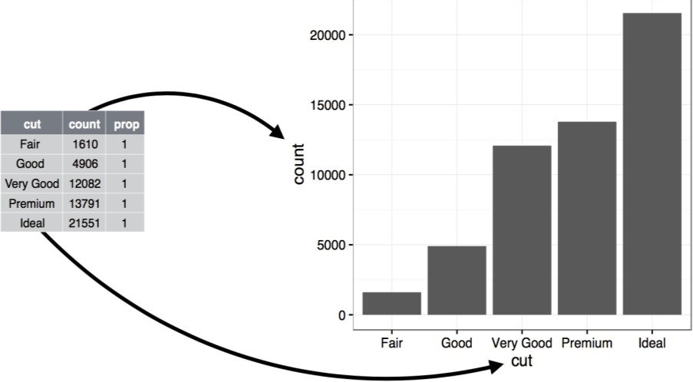
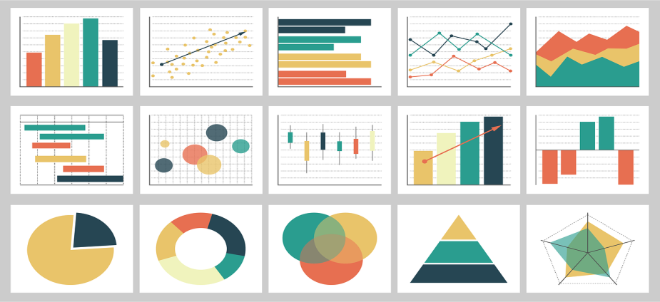
Overview of Data Visualization
What is Data Visualization?
The graphical representation of information and data using visual elements such as charts, graphs, and maps.
Data visualization is not limited to just the graphical representation of data. While visual representations like charts, graphs, and plots are a key part of it, data visualization also involves:
Simplifies complex data: Organizes large datasets for easier understanding.
Communicates insights: Reveals hidden trends, patterns, and correlations.
Facilitates decision-making: Aids in interpreting data for informed analysis.
Purpose:
Helps in understanding complex data through visual context.
Visualizing data allows people to see relationships, patterns, and
trends in the information you’re trying to communicate.
Examples:
Charts: Bar charts, pie charts, etc.
Maps: Geospatial data visualizations.
Dashboards: Interactive data summaries.
Recent trends:
Augmented and virtual reality (AR/VR) visualizations
Real-time and streaming data visualizations
AI-assisted data visualization tools
6

Slide 6
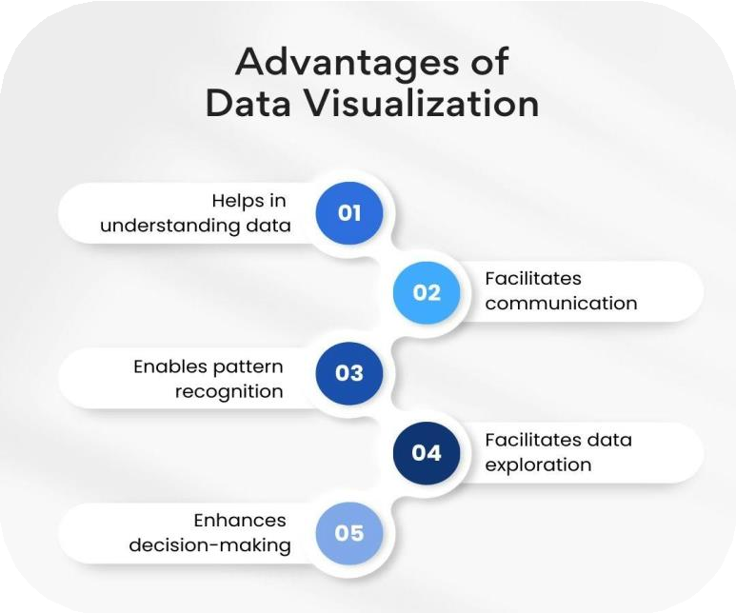
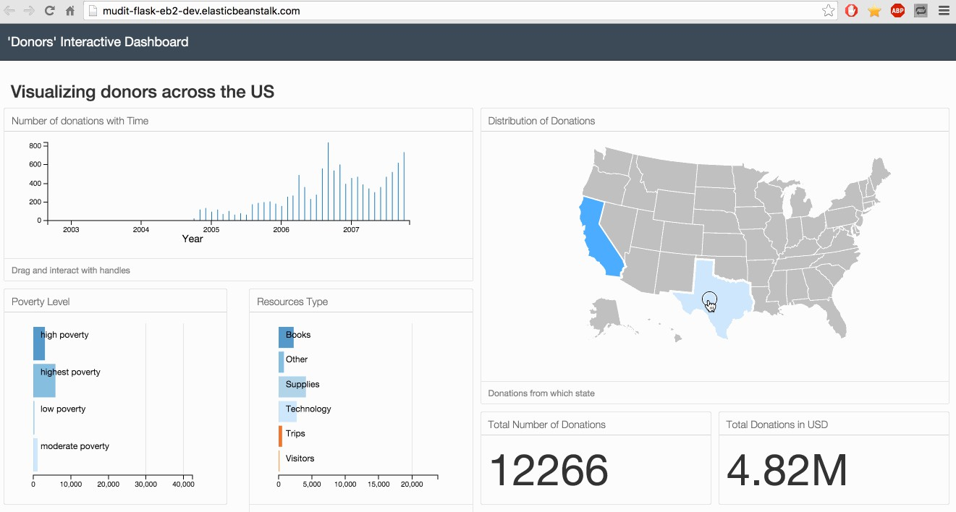
Importance of Data Visualization in Data Science
Trend Analysis: Identify patterns over time.
Outlier Detection: Easily spot anomalies.
Insight Communication: Simplifies complex data for stakeholders.
Decision support: Enabling quick and informed choices based on visual insights
Pattern recognition: Identifying trends and anomalies that may
be missed in raw data.
Example of an interactive dashboard:

Slide 7
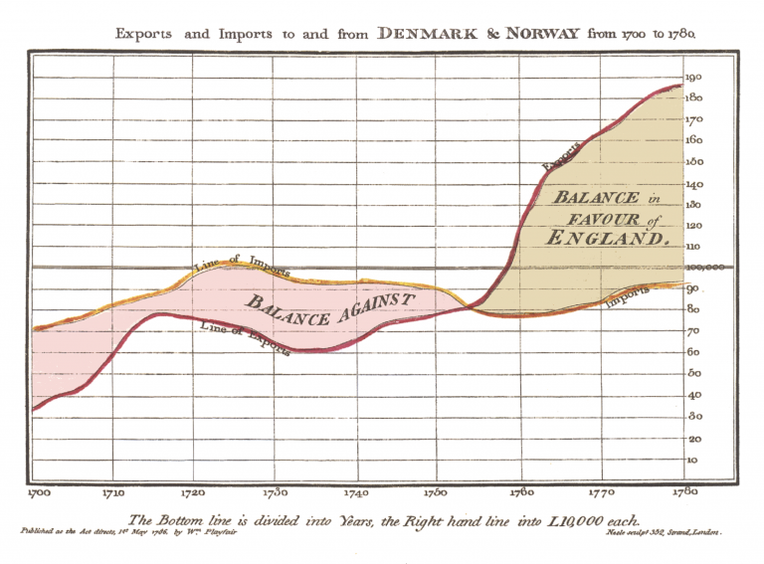
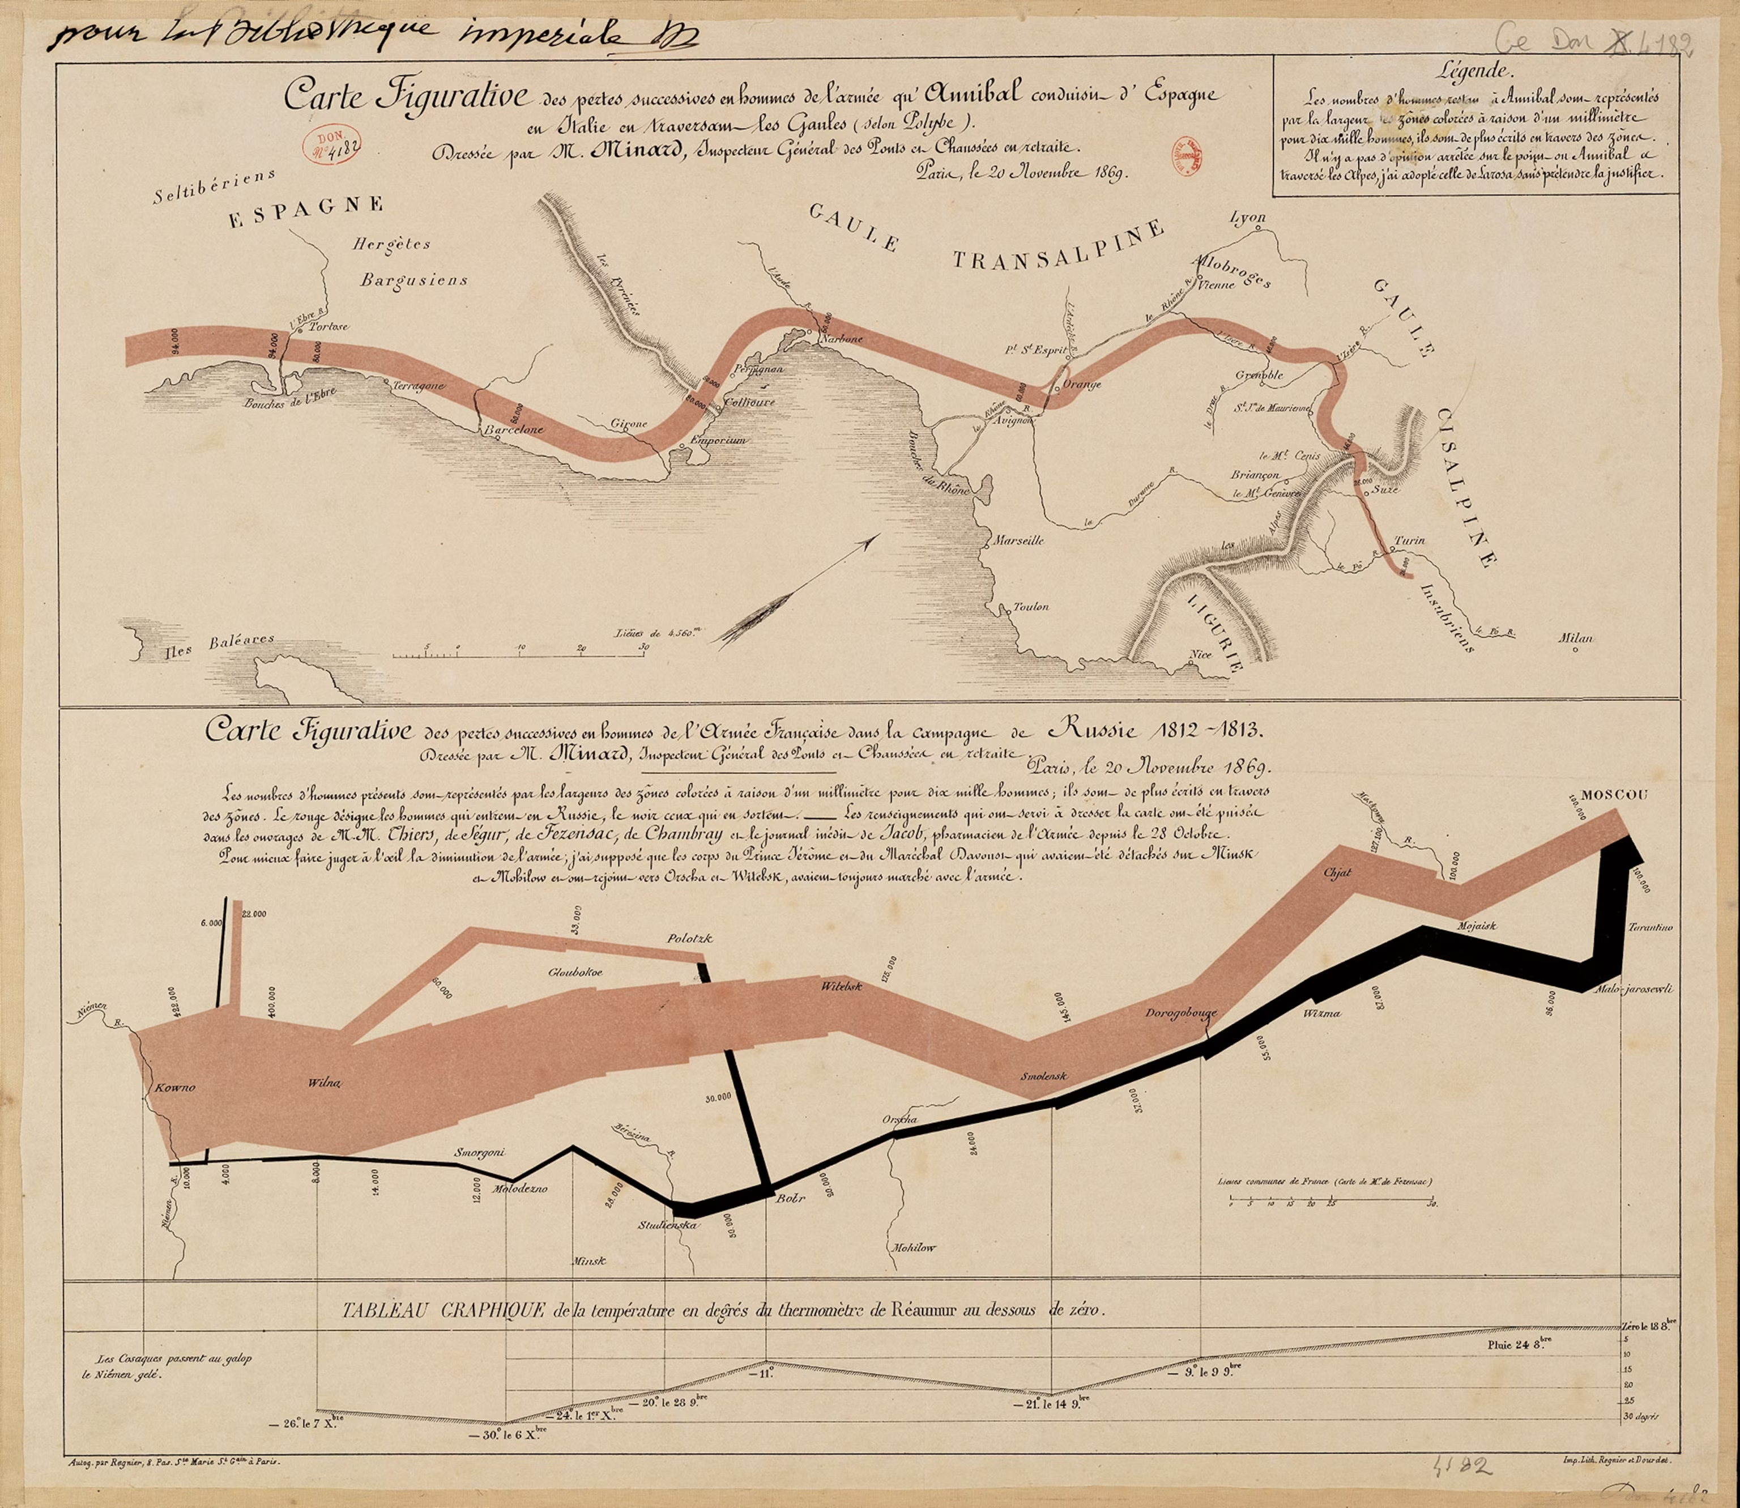
History and Evolution of Data Visualization
Early Beginnings:
1600s:
Maps and simple charts used for navigation and trade.
William Playfair introduced:
Line charts for trends over time.
Bar charts for comparative analysis.
1700s:
Development of pie charts for proportional data representation.
1800s: Pioneering Works
Charles Minard’s "Napoleon’s March":
Combines multiple data dimensions (e.g., geography, temperature, troop size).
A landmark in storytelling through visualization.
Florence Nightingale:
Rose diagrams for medical statistics.

Slide 8
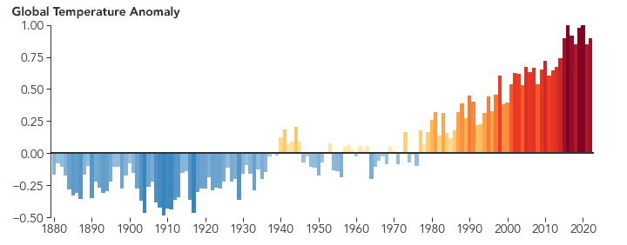
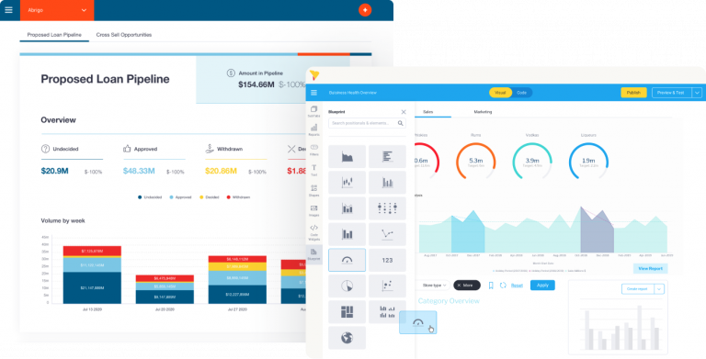
History and Evolution of Data Visualization
1900s:
Introduction of computers:
Enabled more complex and precise visualizations.
Early graphical software for statistical analysis.
John Tukey’s Exploratory Data Analysis:
Promoted the use of visual methods to uncover data patterns.
Modern Era: Interactive & Big Data Tools
Emergence of dynamic and interactive tools:
Tableau, Power BI, Plotly for user-driven insights.
Focus on accessibility:
Data storytelling tailored for diverse audiences.
Incorporation of AI:
Automated insights and recommendations in visualization tools.

Slide 9
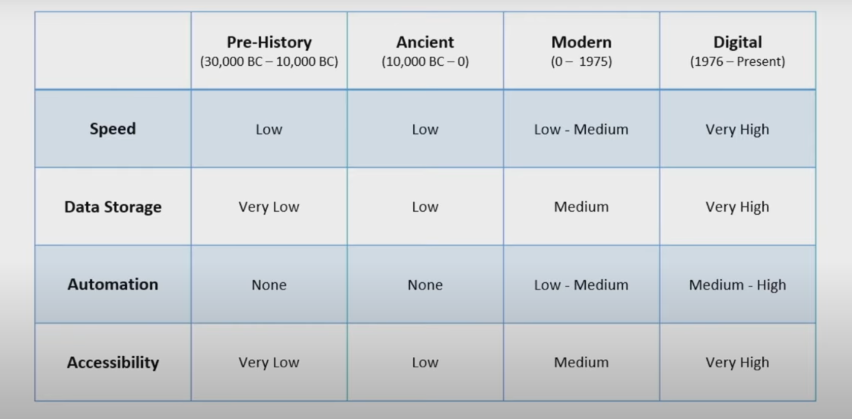
Data Visualization Growth Over Periods of time
Stanford Lecture About History of DataViz
https://youtu.be/N00g9Q9stBo?si=0MldlsGhECqgUkSd

Slide 10
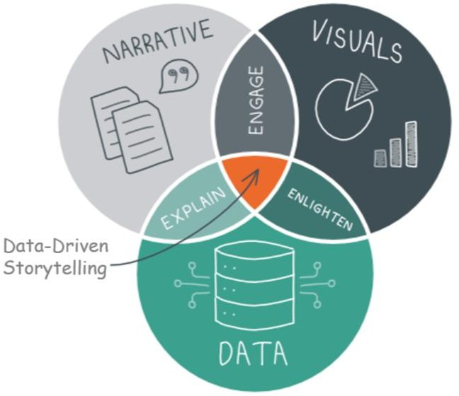
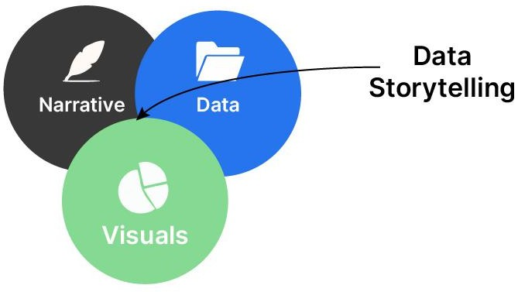
Storytelling with Data: Communicating Insights Effectively
Definition:
Data storytelling is the practice of creating a compelling narrative
using data to convey insights clearly and effectively.
It goes beyond mere visualization, aiming to make data meaningful and impactful.
Purpose:
To make complex information accessible, understandable, and
memorable to diverse audiences.
To bridge the gap between data analysis and decision-making.
Key Elements:
Data: The foundation of the story, providing factual content.
Visuals: Graphical representations that helps illustrate the data.
Narrative: The context and explanation that connects the data and visuals, providing meaning and insights.

Slide 11
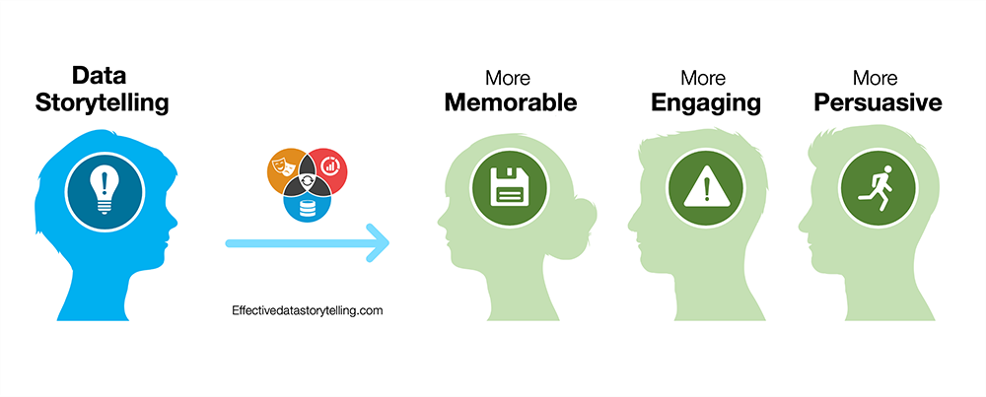
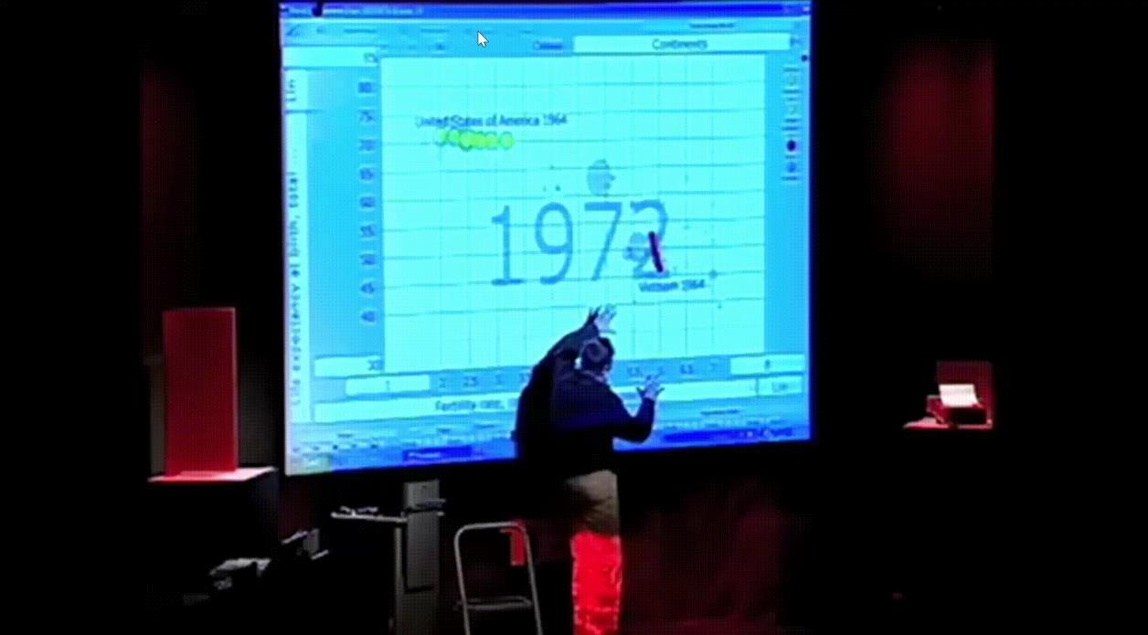
The Importance of Data Storytelling
Why Data Storytelling Matters:
Enhances Understanding: Transforms complex data into a narrative, making it easier to comprehend.
Engages the Audience: Captivates and holds attention,
making data more memorable.
Bridges Data and Decision-Making: Makes complex information accessible, facilitating informed decisions.
Drives Action: Encourages change by presenting insights in an impactful way.
Improves Retention: Helps people remember data through compelling stories.
Real-World Example:
Hans Rosling's TED Talk: Link
Lecture, “The Best Stats You’ve Ever Seen”
Used animated bubbles to show global health trends over time.
Made complex demographic data engaging and
understandable.
9

Slide 12
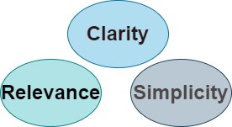
Principles of Good Data Storytelling
Clarity: Make the message easy to understand
Simplicity: Avoid unnecessary complexity
Relevance: Focus on what matters to the audience
Steps in Data Storytelling:
Collect Data: Gather relevant data points
Analyze Data: Identify key insights
Visualize Insights: Use visual aids to convey
the story

Slide 13
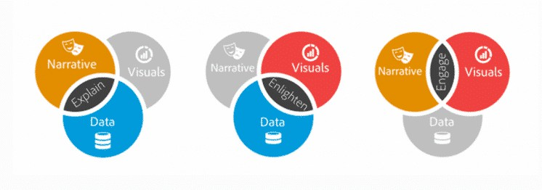
Data Storytelling vs. Data Visualization
Data Visualization:
Graphical representation of data (charts, graphs, maps)
Aims to present information efficiently and clearly.
Enables quick grasp of patterns and trends
Data Story Telling:
Uses narratives, context, and visuals to communicate insights.
Aims to engage audience emotionally and make data memorable
Follows a narrative structure (beginning, middle, end)
Key Difference:
Data visualization is a tool used within data storytelling.
Data storytelling goes beyond to create a compelling narrative

Slide 14
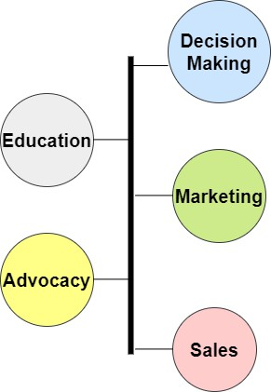
Applications of Data Storytelling
Decision-Making
Presenting data in a narrative format, enabling decision makers to easily
grasp the significance of the data and understand its implications.
Business & Advocacy
Marketing: Communicates product value
Sales: Demonstrates service impact
Advocacy: Illustrates cause importance
Education & Training
Engages students and participants
Improves grasp of key insights
Enhances information retention

Slide 15
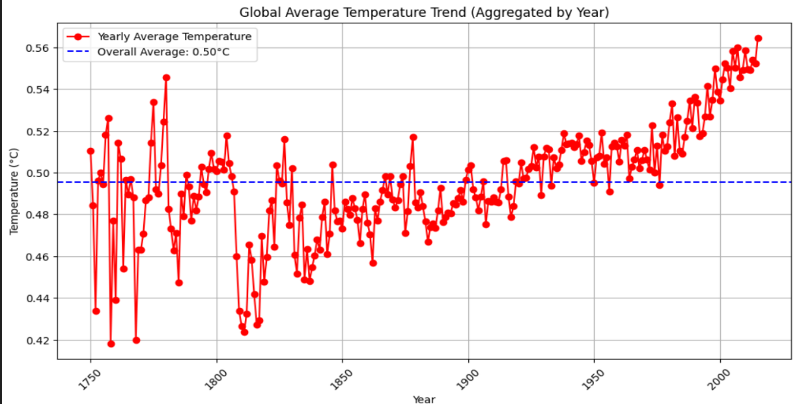
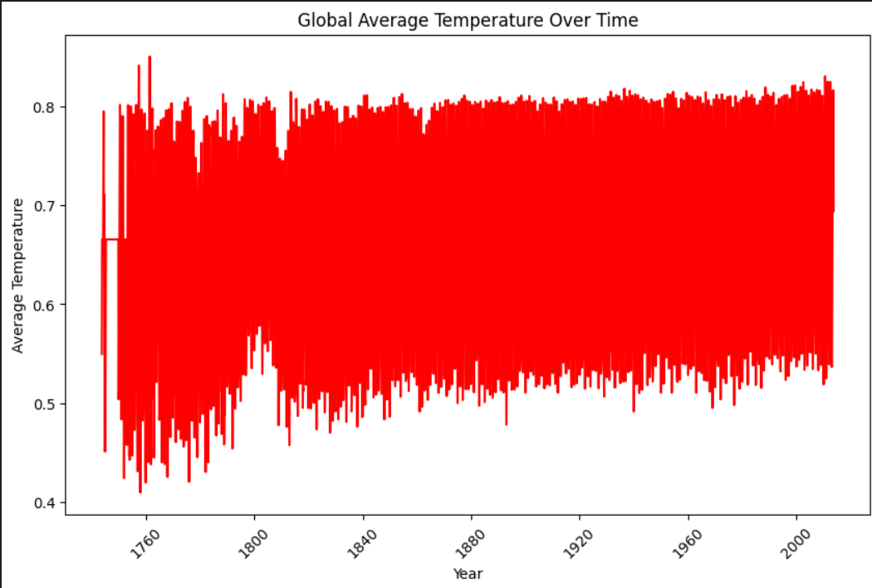
Effective vs. Ineffective Visualizations
Effective Visualizations:
Clear labeling.
Appropriate use of Chart types.
Consistent and logical scales.
Ineffective Visualizations:
Overloading with information (chart junk).
Misleading scales or truncated axes.
Poor choice of colors (e.g. low brightness ).

Slide 16
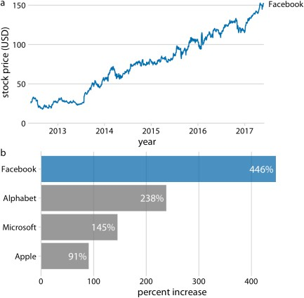
Case Studies
Facebook Stock Growth
Growth of Facebook stock price over a five-year interval and comparison with other tech stocks.
The Facebook stock price rose from around
$25/share in mid-2012 to $150/share in mid-
2017, an increase of almost 450%.
The prices of other large tech companies did not rise comparably over the same time period. Price increases ranged from around 90% to almost 240%. Data source: Yahoo! Finance.

Slide 17
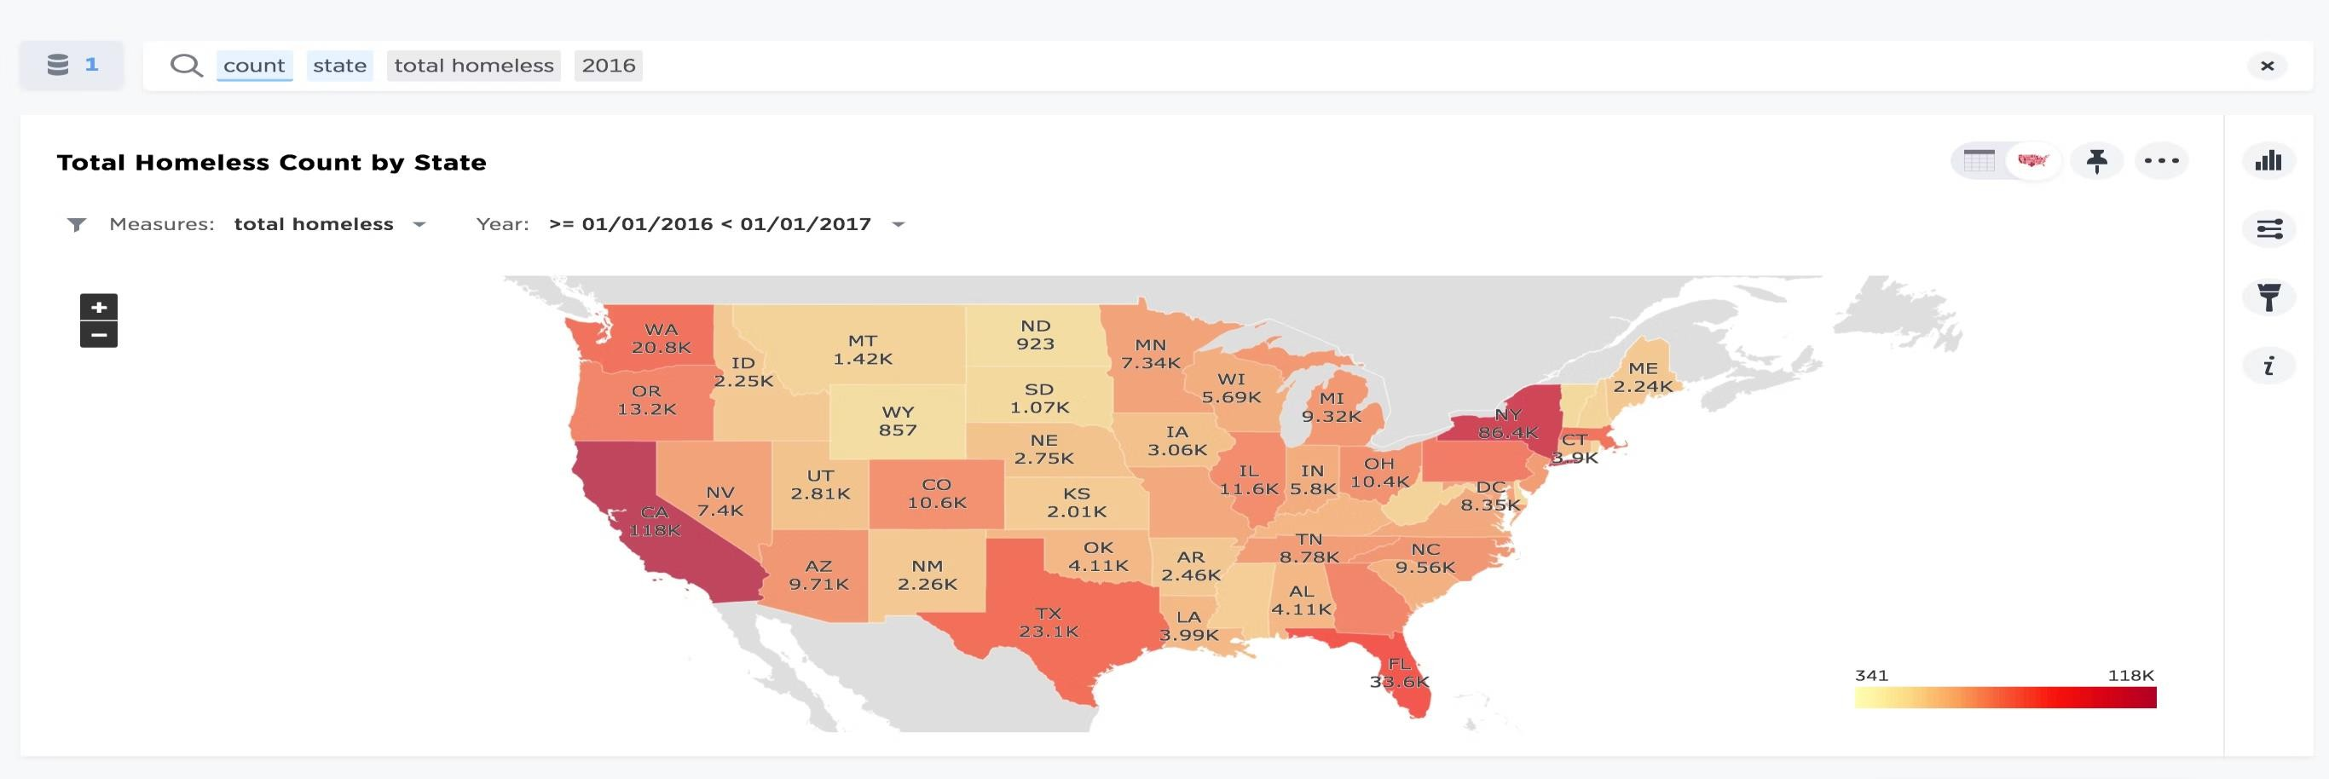
Case Studies
Homeless in America
Visualization: Map of the US with color-based density indicators
Impact: Quickly shows where homelessness is most acute across the country
Benefit: Simplifies complex data for easy understanding without technical expertise

Slide 18
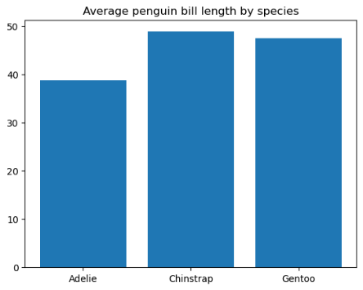
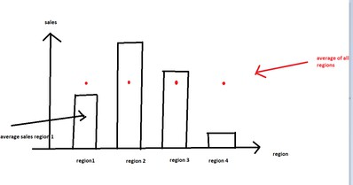
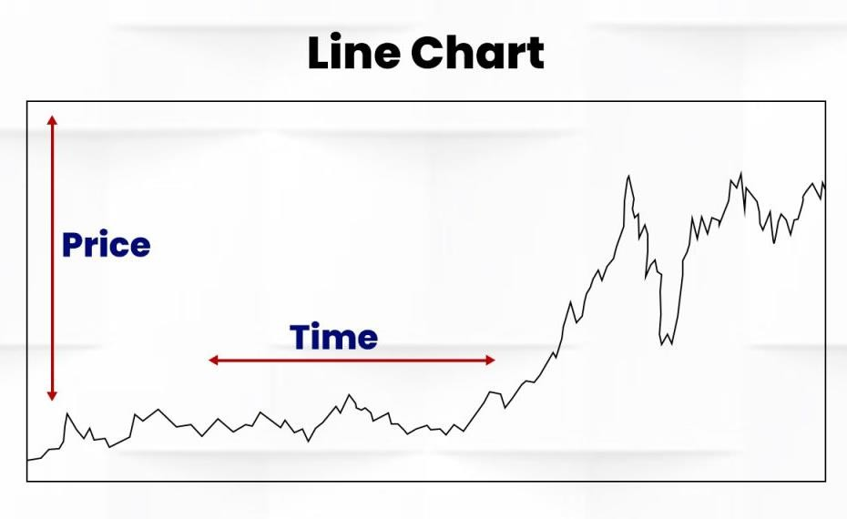
Common Types of Data Plots
Creating data plots is an essential step of exploratory
data analysis
Bar Chart
Use Case: Comparing quantities across categories.
Example: Sales data across different regions.
Features:
Easy to compare different categories side by side.
Useful for categorical data.
Line Plot
Use Case: Show trends over time.
Example: Stock price changes over a month.
Features:
Illustrates continuous data and trends.
Ideal for time series data.

Slide 19
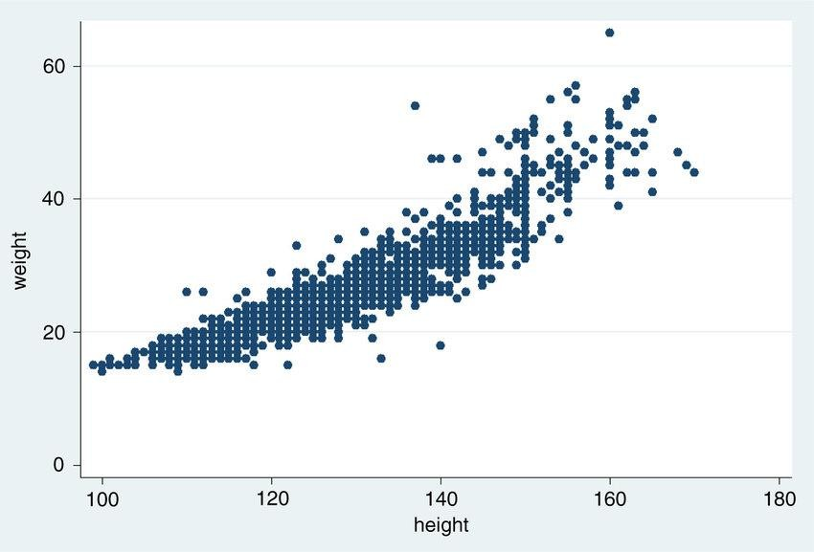
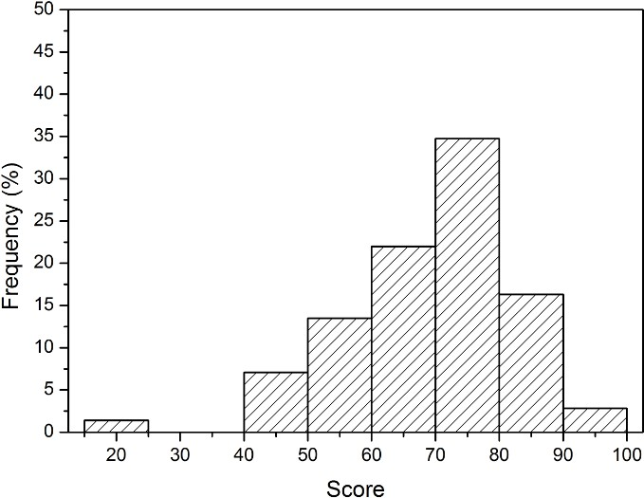
Common Types of Data Plots
Scatter Plot
Use Case: Show relationships between two
variables
Example: Height vs. weight in a population.
Features:
Helps identify correlations, patterns, and outliers.
Useful for regression analysis.
Histogram
Use Case: Display the frequency distribution of a variable.
Example: Showing the frequency distribution of
test scores in a class
Features:
Provides insight into the spread and shape of data distribution.
Helps identify patterns such as skewness or
normality.
16

Slide 20
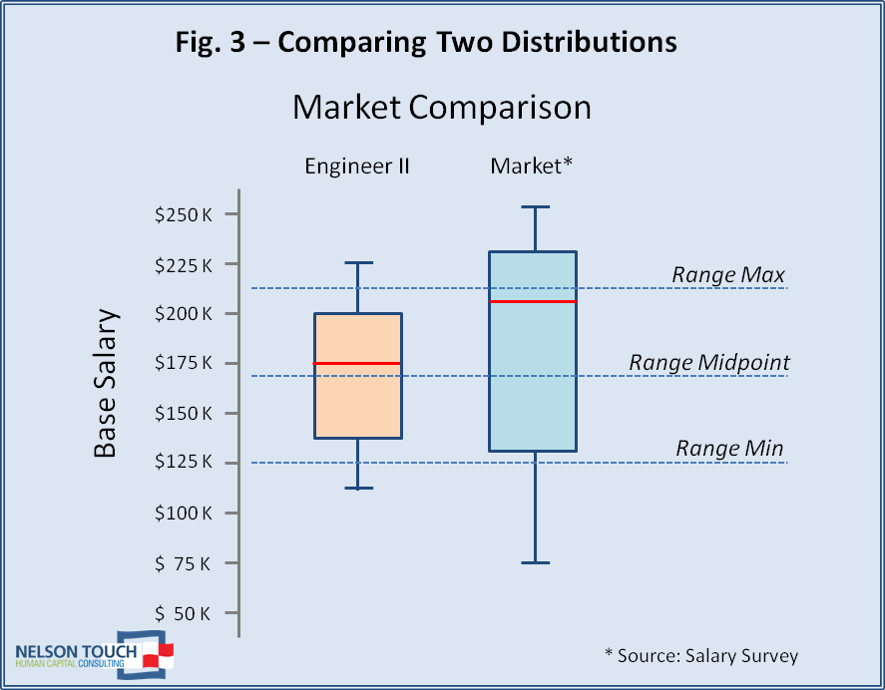
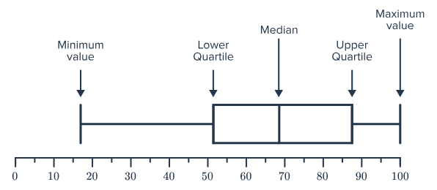
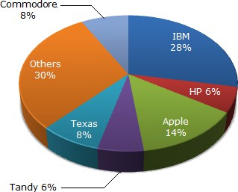
Common Types of Data Plots
Box Plot (box-and-whisker plot)
Use Case: Display the distribution and outliers of data.
A box plot is a data plot type that shows a set of five descriptive statistics of the data: the minimum and maximum values (excluding the outliers), the median, and the first and third quartiles. Optionally, it can also show the mean value.
Interquartile Range (IQR): The distance between the first and third quartiles (Q3 - Q1), representing the spread of the middle 50% of the data.
Outliers: Data points that fall significantly outside the IQR (typically more than 1.5 times the IQR from Q1 or Q3).
Example: Distribution of salaries in a company.
Pie Chart
Use Case: Show proportions within a whole.
A pie chart is a type of data visualization represented by a circle divided into sectors, where each sector corresponds to a certain category of the categorical data, and the angle of each sector reflects the proportion of that category as a part of the whole
Example: Market share of companies.
The pie chart shows the distribution of New York market share by value of different computer companies in 2005.
17

Slide 21
Types of Data Plots We Will Learn…
Line Plot
Scatter Plot
Bar Chart
Histogram
Pie Chart
Stacked Bar Chart
Box Plot
Violin Plot
Strip Plot
Swarm Plot
Heatmap
Pair Plot
Density Plot
Area Chart
Bubble Chart
Donut Chart
Step Chart
Bar Chart with Error Bars
Grouped Bar Chart
Time-Series Plot
3D Scatter Plot
3D Surface Plot
Chord Diagram
Tree Map
Radar Chart
Funnel Chart
Waterfall Chart
Geospatial Plot
Network Graph
Interactive Dashboard Elements
17

Slide 22
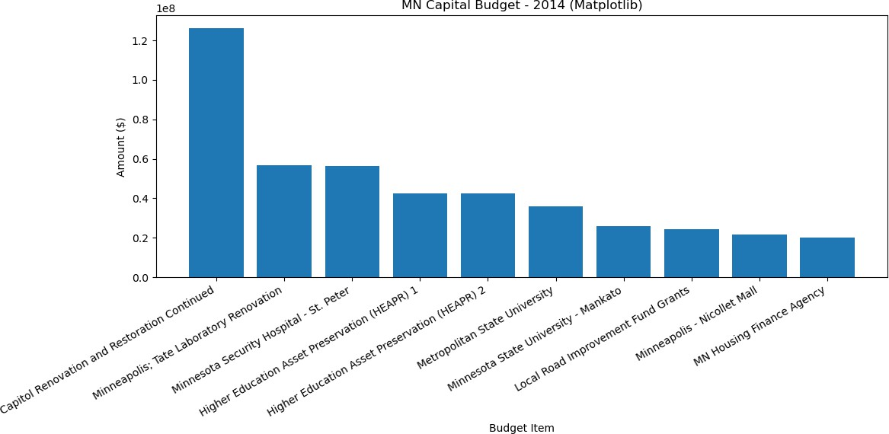
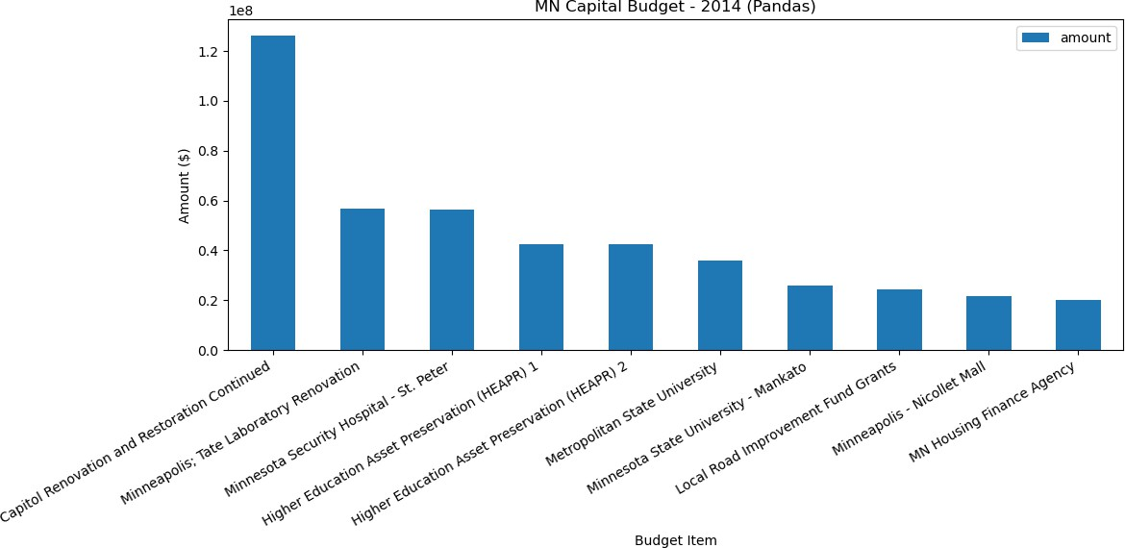
Data Visualization Tools
Overview of Python Libraries for Data
Visualization
Python has become a dominant language in data science, offering a rich ecosystem of visualization libraries.
Matplotlib
Matplotlib is the grandfather of python visualization
packages.
Foundation for many other libraries.
It is extremely powerful but with that power comes complexity.
Best for creating publication-quality static visualizations.
Example: Line plots, bar charts.
Pandas
Built-in plotting functions based on Matplotlib.
Features:
Convenient for quick visualizations directly
DataFrames.
Ideal for simple, exploratory plots.
Use Case: Rapid, straightforward plotting.
Example: Quick plots from Dataframes.
from
18

Slide 23
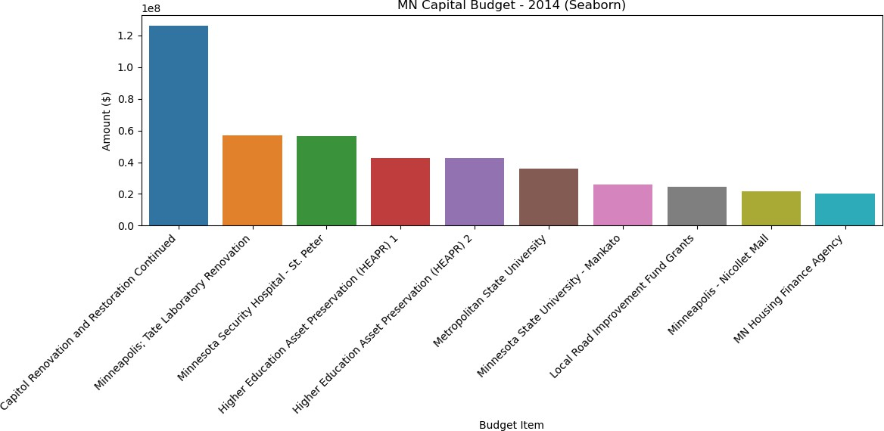
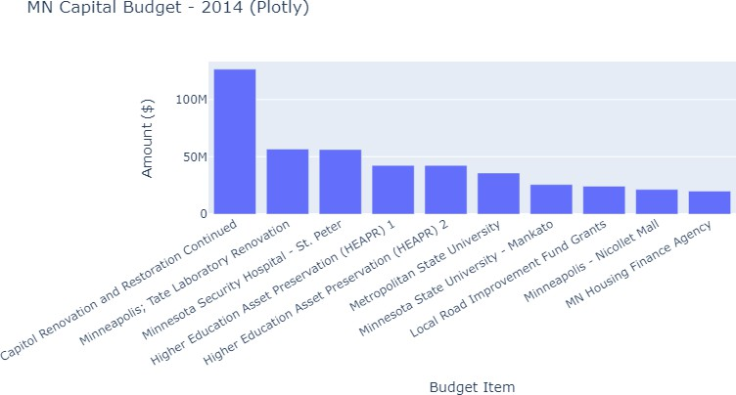
Overview of Python Libraries for Data Visualization
Seaborn
Visualization library based on Matplotlib.
Features:
Leverages matplotlib for beautiful, minimal-code charts.
It’s default styles and color palettes are more modern and visually appealing.
It also has the goal of making more complicated
plots simpler to create.
Specialized in statistical visualizations.
Example: Heatmaps, pair plots.
Plotly
Overview: Creates interactive, web-based
visualizations.
Features:
Supports diverse chart types and maps.
Ideal for dashboards and web applications.
Handles real-time data and complex interactivity.
Example: 3D plots, interactive dashboards.
19

Slide 24
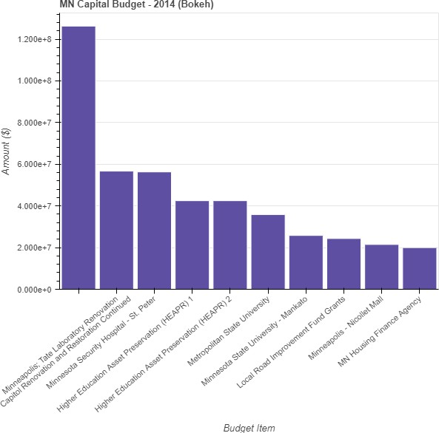
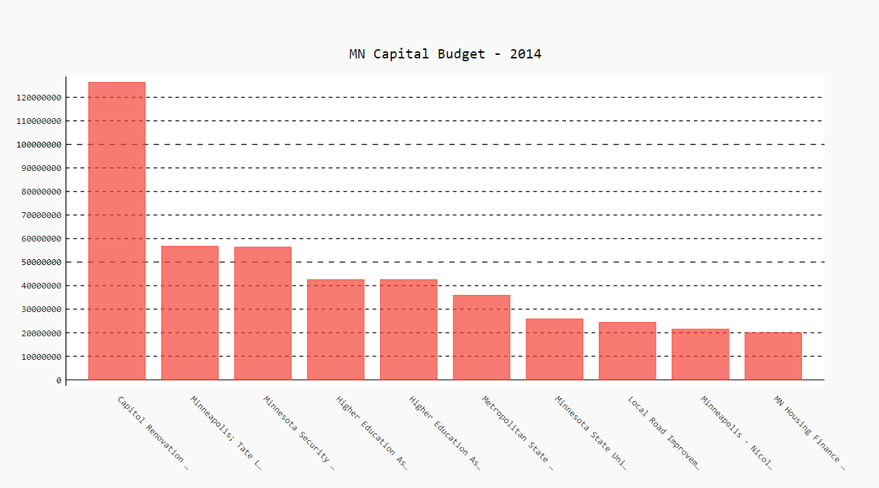
Overview of Python Libraries for Data Visualization
5. Bokeh
Overview: Python library for interactive plots and applications.
Use Case: Web-based visualizations and large datasets.
Features: Supports streaming and real-time data.
Example: Interactive web-based visualizations.
Pygal:
Overview: Python
charts.
library for creating SVG
Features: Generates interactive, high-quality vector graphics.
Use Case: Ideal for producing visually appealing and scalable charts.
Example: Interactive and customizable charts for
web applications.

Slide 25
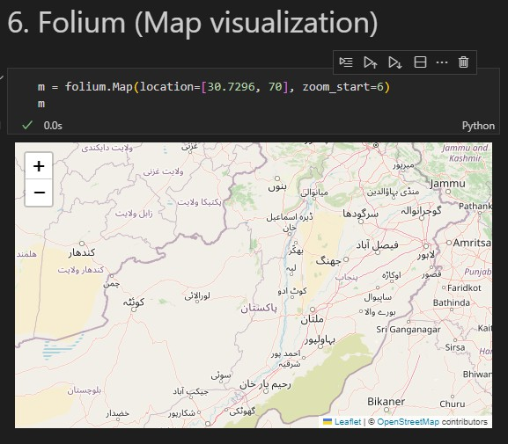
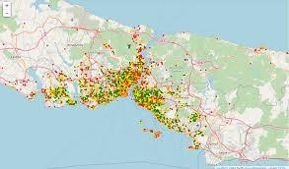
Overview of Python Libraries for Data Visualization
Folium
Overview: Python library for interactive maps.
Backend: Utilizes Leaflet.js (a popular JavaScript library for interactive maps).
Use Case: Geospatial data visualization.
Features: Specializes in creating interactive, mobile-friendly maps.
Example: Visualizing geographic data interactively.

Slide 26
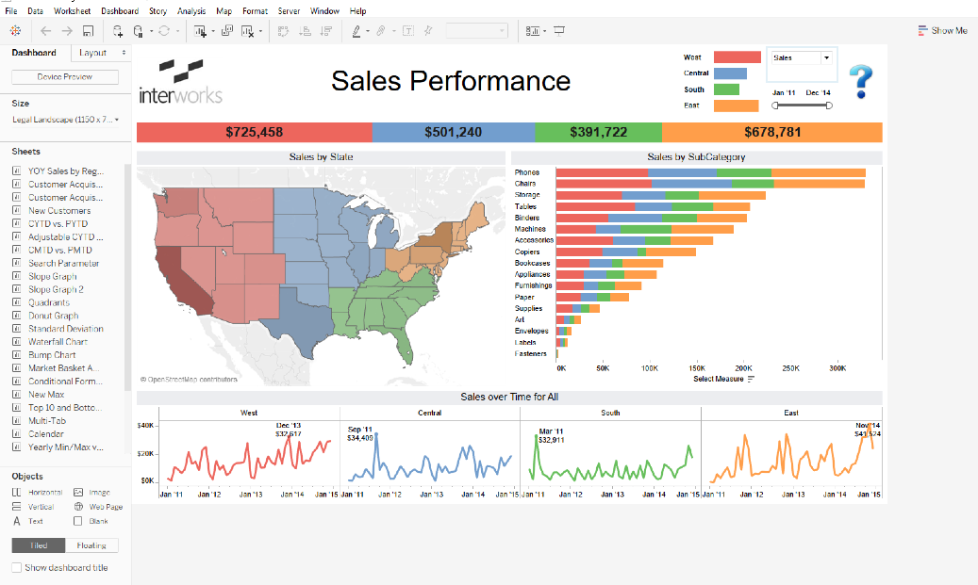
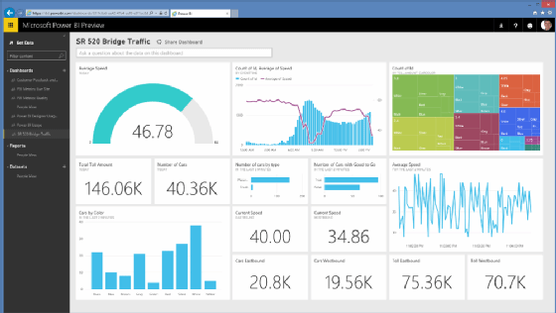
Other tools for Data Visualization
Tableau
Overview: Python library for interactive maps.
Backend: Utilizes Leaflet.js (a popular JavaScript library for interactive maps).
Use Case: Geospatial data visualization.
Features: Specializes in creating interactive, mobile-friendly maps.
Example: Visualizing geographic data interactively.
Power BI
Overview: Python library for interactive maps.
Backend: Utilizes Leaflet.js (a popular JavaScript library for interactive maps).
Use Case: Geospatial data visualization.
Features: Specializes in creating interactive, mobile-friendly maps.
Example: Visualizing geographic data interactively.

Slide 27

Summary and Next Steps
Key Takeaways:
Understanding the types and sources of data.
Recognizing the importance of data visualization in data science.
Understanding how storytelling with data enhances communication and decision-making.
Familiarity with common types of plots and their applications.
Bar, line, scatter, histogram, box, pie charts.
Introduction to essential Python libraries and other tools for data visualization.
Matplotlib, Pandas, Seaborn, Plotly, Bokeh, etc.
Power BI, Tableau

Slide 28
Thank You

